Slide 1

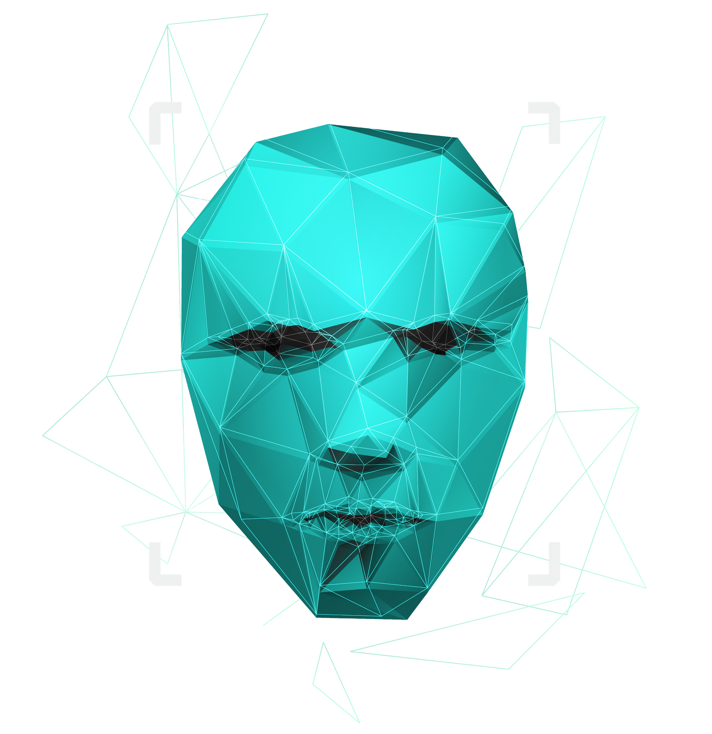
An optimized approach for Paternity Testing
using rs numbers and whole genome
Team Members:
Youssif Assem, Mohamed Moataz, Kareem Ehab, Mohamed Akram, Ahmed Gamal
Supervised by :
Dr. Ashraf Abdelraouf
Eng. Ahmed Hazem
Eng. Mahmoud Elsahhar

Slide 2

Agenda
Introduction
Purpose
System Overview
Methods
Dataset
Conclusion
Results

Slide 3

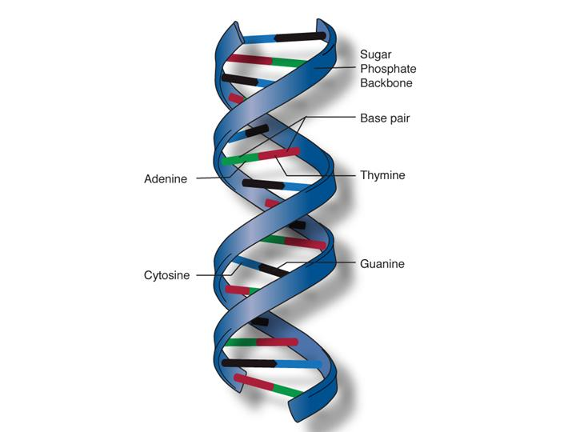
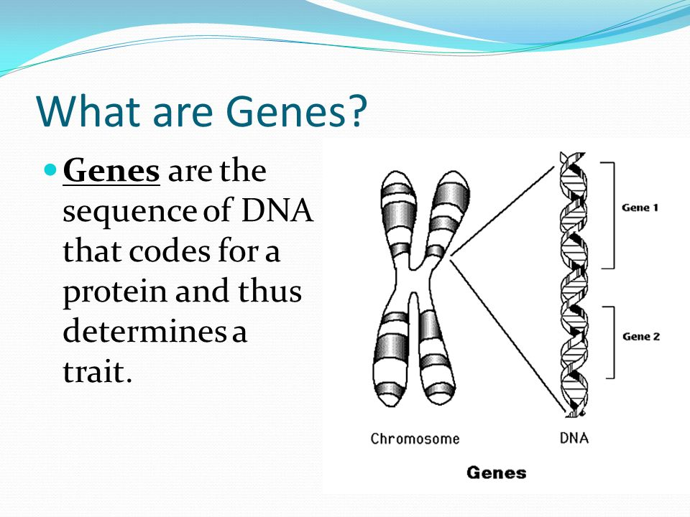
Introduction
DNA
DNA molecules allow some of our characteristics to be passed down from our generation to the next (our children)
Genes →Genes are passed from parents to offspring and contain the information needed to specify traits(qualities). Genes contains a subset of the DNA and this subset is (A, T, C, G).
1

Slide 4
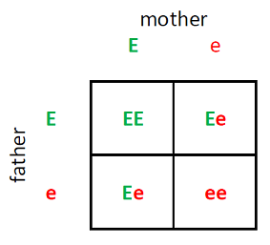
Introduction
What is an Rs-number?
It is a unique reference number to the gene we have that consists of two alleles (one from the father and the other from the mother).
What is an Alleles ? It is a two characters represents the gene sequence repeats of characters one from father and another one from mother
EX:
RsNumber | Father | Mother | Child1 | Child2 | Child3
rs3131972 | AG | GG | AG | GG | GG
2

Slide 5
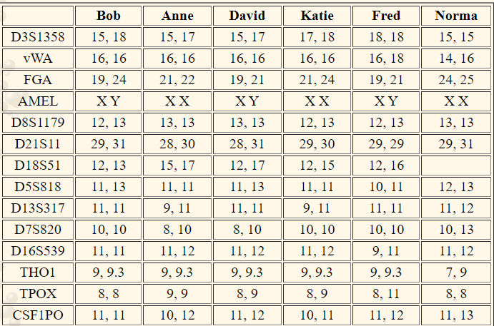
Introduction
Whole genome
It is the whole DNA sequence that a human have in their system.
Each number in the Table represents the repeats of nucleotide.
Ex:
ATCGATCGATCGATCGATCGATCGATCGATCGATCGATCG
3

Slide 6


Purpose
Our system's major purpose is divided into two main categories.
1) proving or rejecting the relationship between the parent and child using the two approaches; either with RS or the whole genome.
2) Target a specific homeless child and obtain the family with the highest similarity for him/her through comparing same rs numbers from different families with this child and finding the one family with the highest probability
4

Slide 7
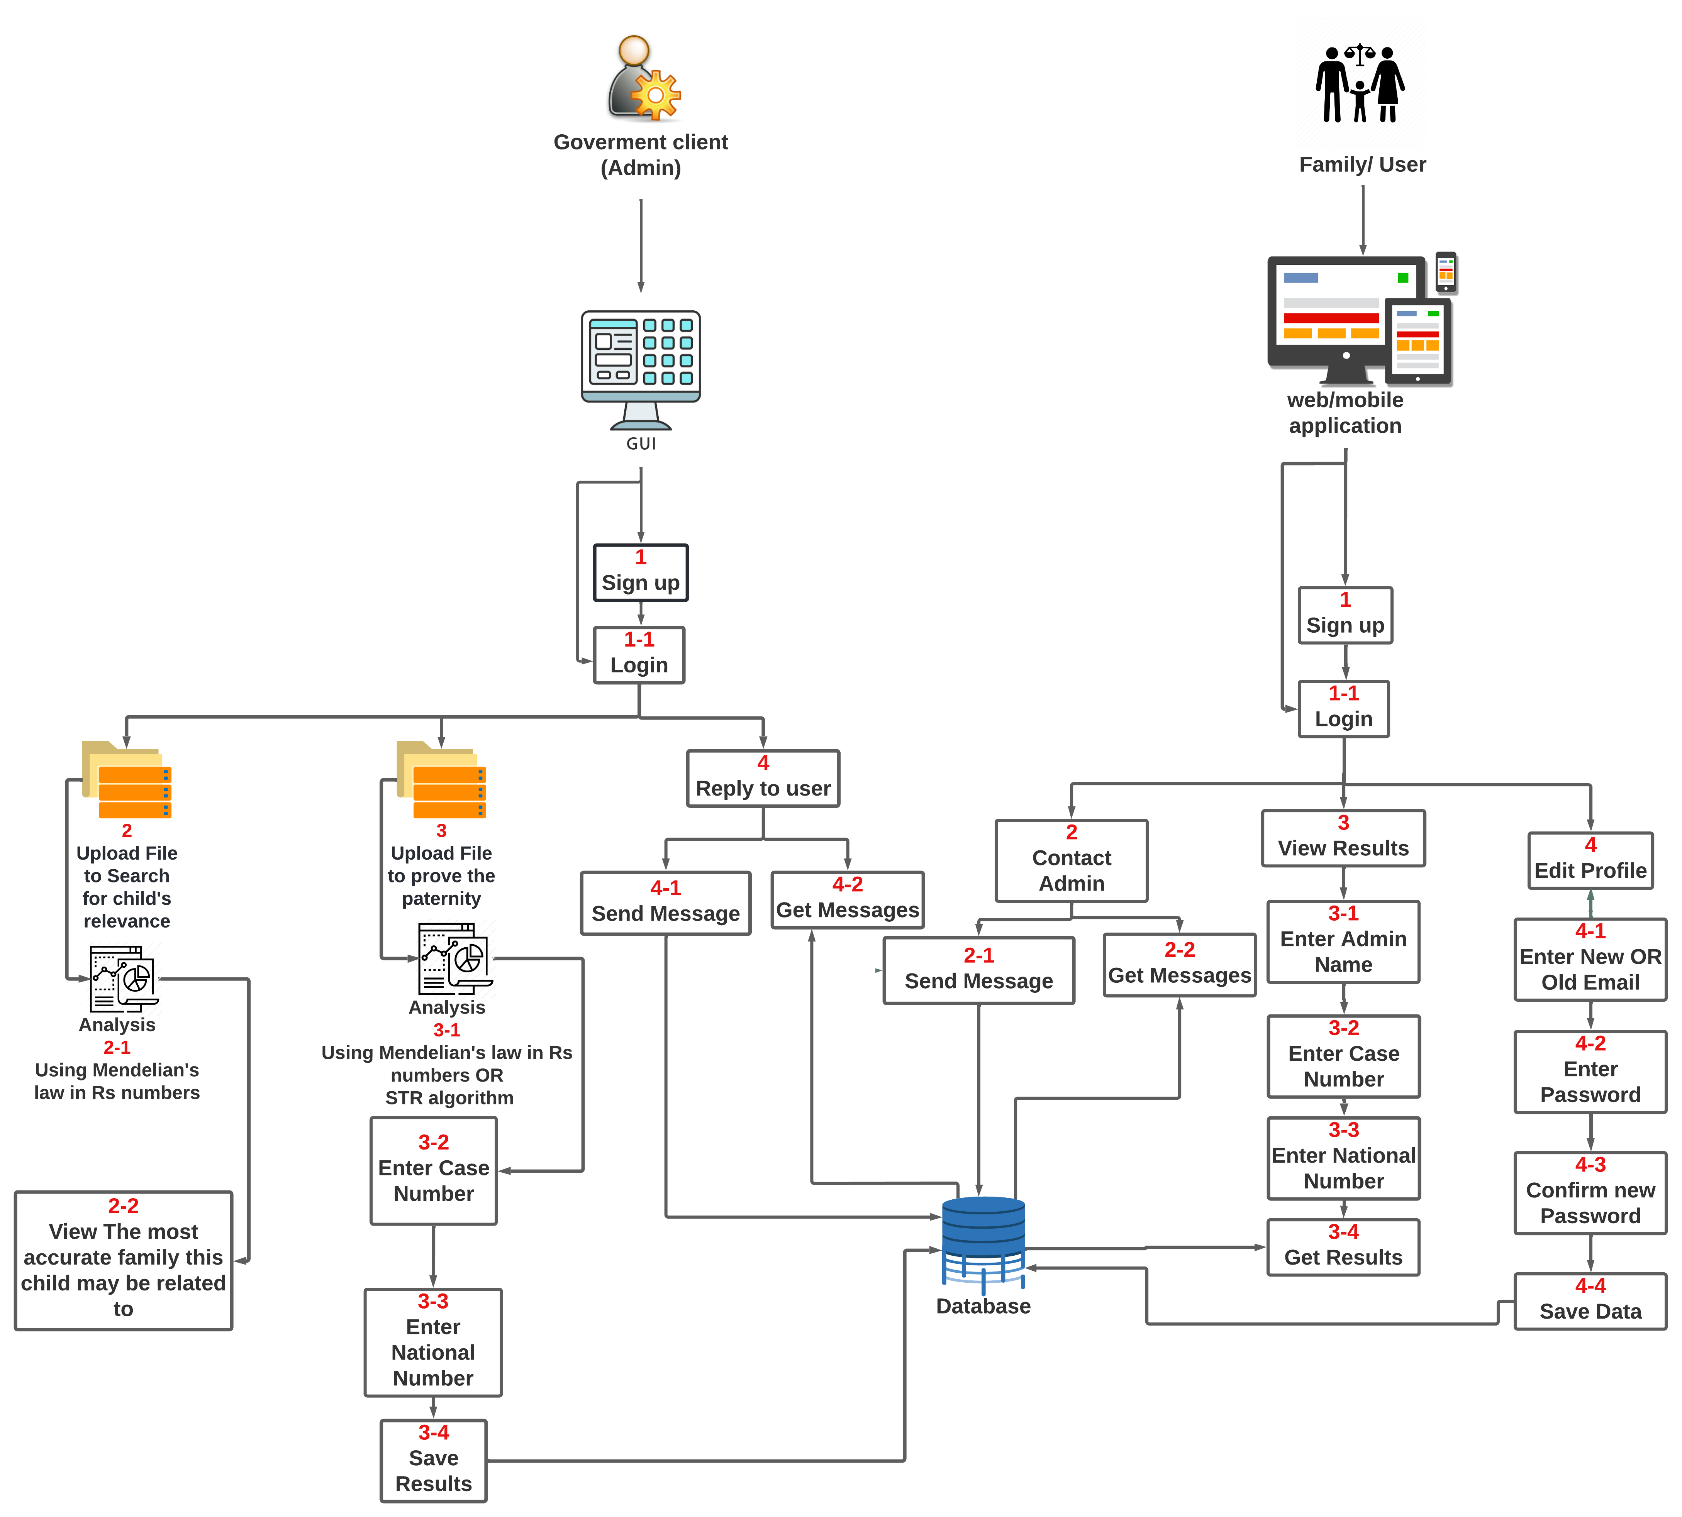
System overview
5

Slide 8
Methods
Methods
Apply Mendelian's Law to prove paternity whether or not the child is related to the targeted father or not
Apply Mendelian's Law to prove if the child is related to family or not
Using short tandem repeat method to
count the repeats nucleotide in the whole genome in each member of the family (mother, father , child)
6

Slide 9
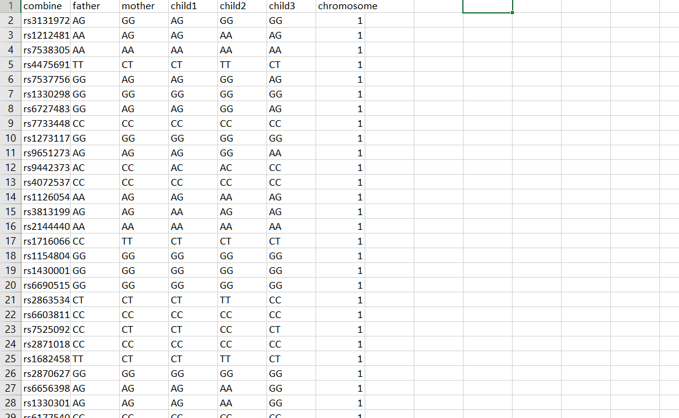
Dataset Used:
Our dataset has over 100000 instances of Rs numbers and consists of 6 main features showing both alleles for every family member and the number of chromosome for each instance
7

Slide 10
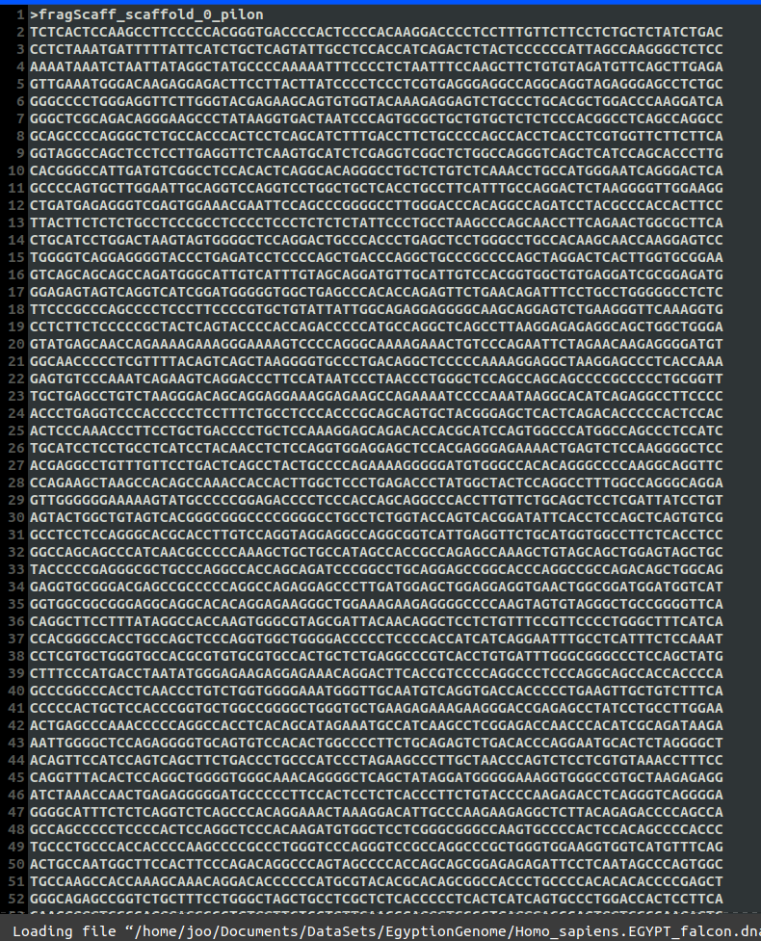
Dataset Used
In the whole genome the process to determine paternity is somewhat different There are specific locations (IDs) or the right terminology (locus, loci) in the whole genome every location and is in a specific chromosome For each of these locations, there exists a specific repeat that we are looking for ex: D7S280 --> GATA counting the number of those repeats for each location is the goal and then comparing it with the number of repeats in the mother and father
8

Slide 11
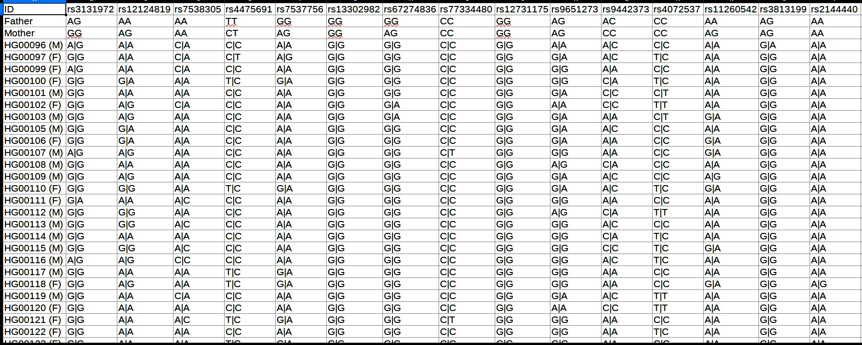
Dataset Used
The second dataset we are using contains 40 rs numbers for over 2000 different people.
The use of this dataset is to find out the highest probability that we can acquire from those people when comparing each one of those alleles to the father.
The highest probability = Highest similarity that the targeted child is indeed related to this father or family.
9

Slide 12
Conclusion
We Applied Mendelian’s Law In Two Different Means
1) Prove if the child is related to father or not.
2) Search for the most accurate family that the target homeless child may be related to.
We applied the STR (short tandem repeat) method to count the number of repeats in the whole genome for determining paternity.
10

Slide 13
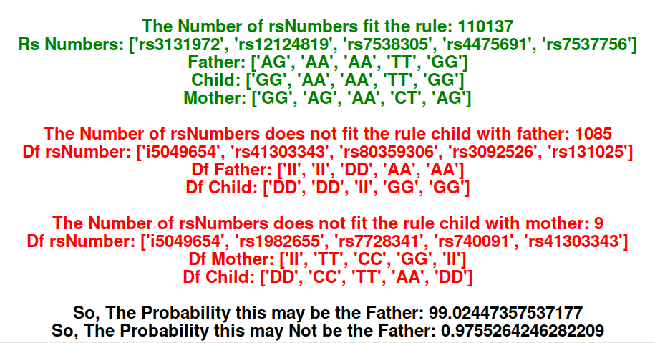
Results
Green Color → Represents the rs numbers and alleles that apply the Mendelian's law which means (child's alleles are indeed inherited from father and mother)
Red Color → Represents the rs numbers and alleles that doesn’t apply the Mendelian’s law which means (child's alleles aren't inherited from father and mother)
Black Color → Represents the probability of how much this child may be related to this father.
Rs Numbers Report
11

Slide 14
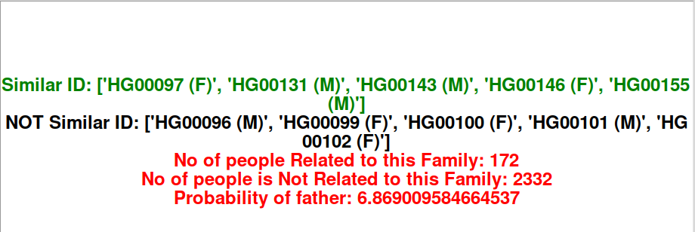
Results
Green Color → IDs of children that are related to the father.
Black Color → IDs of children that are not related to the father.
Red Color → Represents the statistics of how many people from the dataset are related to the father, how many people are not related to the father, and the statistics of how many children are related to father over the total number of children.
Relevance Report
12

Slide 15
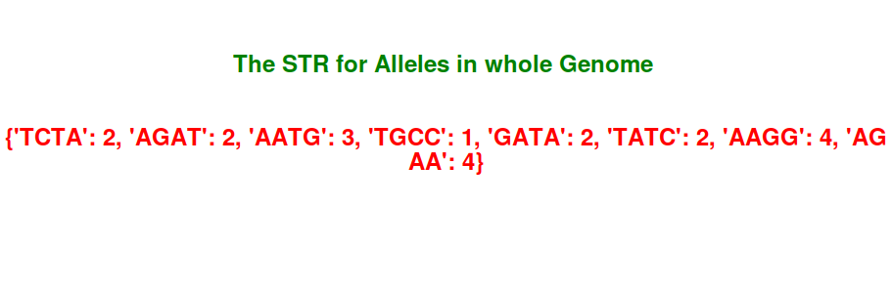
Results
As we have explained in previous slides , short tandem repeat method works by obtaining specific repeats from specific locations on the whole genome
The following slide represents the results for the Short tandem repeat method
We collected the number of repeats for different locations on the whole genome for 1 person
STR repeats
13

Slide 16
THANK You!
Do you have any questions? ☺

